Slide 1
DEVELOPMENT OF A TELUGU APP FOR FARMER PRODUCT SALES AND SERVICES.
Under the guidance of
Dr. R.Ponnuswamy
Professor CSE Dept
S.Anirudh Reddy (14B81A0524)

Slide 2
INDEX:
ABSTRACT
INTRODUCTION
LITERATURE SURVEY
EXISTING SYSTEM AND PROPOSED SYSTEM
SYSTEM ARCHITECTURE
MODULES
SYSTEM CONFIGURATION.
DESIGN
CONCLUSION

Slide 3
ABSTRACT:
Indian most of the population is dependent on agriculture. However, there is also need to review and revitalize the mechanism for updating the technology. In the upcoming years agriculture will see major changes.The large amount of crop is getting damage in the field due to the bacterial attacks and lack of information resources. Annually, such loss exceeds 40% in total. So, the paper presented here suggest various ways in which a farmer can utilize on their handsets using application called “Farmer app”, to assist them for relatively better cultivation and merchandise. Our proposed Farmer application will provides the details about customer and farmer and also it avoids the third party buyer problem which cause problem for farmers.

Slide 4
INTRODUCTION:
Now a days, many android applications are available which provides many smart things to the users Google’s Android Operating System in Mobile phones are still relatively new, however, Android Operating System has been progressing quite rapidly.
Easy access to thousands of applications via the Google Android App Market – When you love to install applications or games, through Google’s Android App Market can download applications for free.
Conceived as a counterpoint IOS, Android is a graph showing a significant development, it certainly cannot be separated from supports major mobile phone manufacturers who participated to bring mobile-phone operating system Android.

Slide 5
MAIN OBJECTIVE
Avoid third party vendor
User friendly

Slide 6
LITERATURE SURVEY:
1)FarmManager: An Android Application for the Management of Small Farms
Smart phone technology creates new opportunities for farm management applications in small farms. Farmers working on small farms are now able with a low cost smart phone and the specialized software (in our case FarmManager) to obtain facilities that couldn’t have on their hands before. The use of the FarmManager software in a smart phone can overleap the high difficulties of farm management requirements which were stand as obstacle for many years so far.
Tasks such as field definition, task operations, lists and reports and all farming use data can be submitted and carried on together in a smart phone at any farm working condition.

Slide 7
2). AGRICULTURE BASED ANDROID APPLICATION.
.This project shows a simulation of live environment which takes different aspects into consideration like market-demandand-supply, production forecast, fertilizer preferences etc.

Slide 8
EXISTING SYSTEM:
In existing system, they use traditional farming method
Traditional farming tolerated unpredicted environment where as, Modern farming provide predictable environment by SMS service.
Traditional farming needs great amount of labour and various activities to go through for conducting farming.
On the other hand Modern farming does not need great amount of labour since the mobile and machines take care of everything.
This system is very slow.
Third party may give less amount of money for farmers.

Slide 9

PROPOSED SYSTEM:
Our proposed Farmer application provides better relationship between customer and farmer.
Our Android app is to enhance transparency in the agriculture commodity marketplace by providing market price information, facilitating collective buying of inputs and collective selling of produce.
Also we facilitate SMS service which send the crop information to their phone over message service.
Area based customer selection is also there in our application.

Slide 10
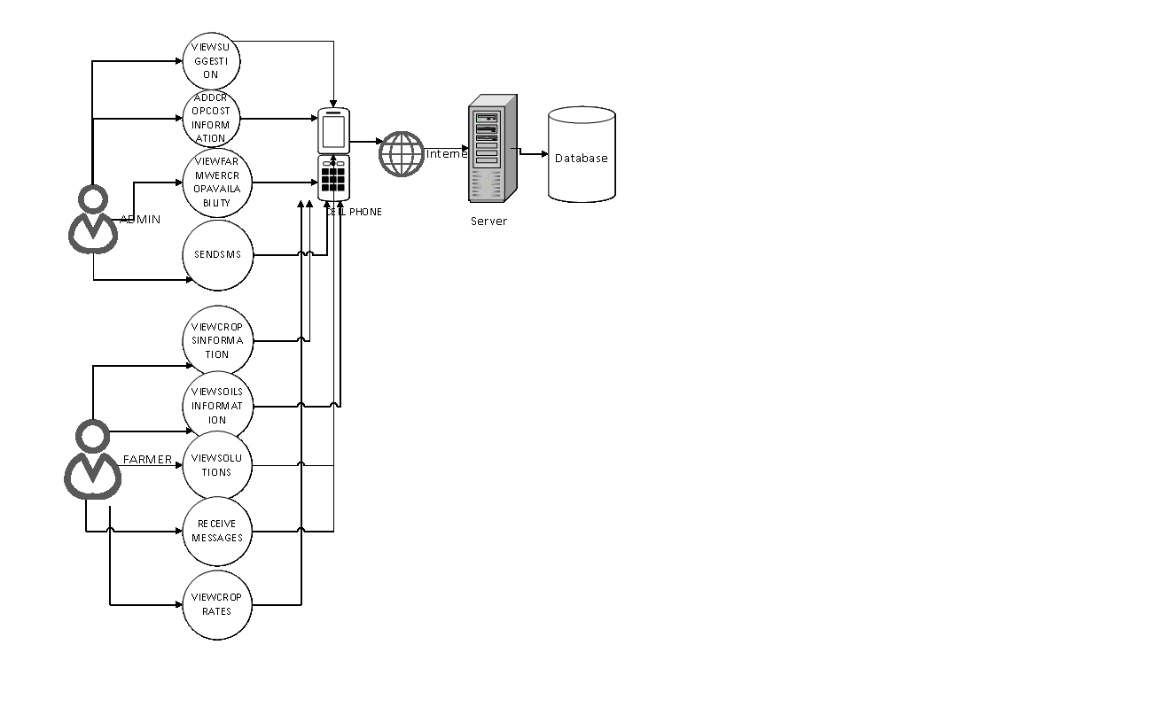
SYSTEM ARCHITECTURE

Slide 11
MODULES:
Crop forming Guidance
Crop Selling on best price
Crop Search by Customers
SMS Services
`

Slide 12
HARDWARE AND SOFTWARE REQUIREMENTS
Hardware Requirements
RAM : 512MB (or) Higher
Hard disk : 1GB
Processor : Any Processor above 500 MHz
Software Requirements
Technology : Android
Front End : JAVA
Back End : SQL LITE
Operating System : Windows7

Slide 13
DESIGN

Slide 14




USECASE DIAGRAM:

Slide 15
FARMER USECASE DIAGRAM:

Slide 16
CLASS DIAGRAM:

Slide 17
ADMIN SEQUENCE DIAGRAM:

Slide 18
FARMER SEQUENCE DIAGRAM:

Slide 19
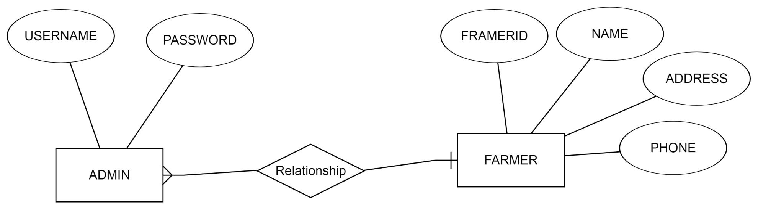
ER DIAGRAM:

Slide 20
CONCLUSION TO OUR PRESENTATION:
We conclude this presentation by saying that our proposed system tries to improve the standards of the existed traditional
farming method and get full benefits to the farmer of the things he grow. Currently we are in Design phase, moving towards implementation part and testing.

Slide 21


THANK YOU

